Slide 1
Securing Computer Folders using Bluetooth and Rijndael Encryption Process
Nikita Saple
Ankita Kesarkar
Dhanraj Poojari

Slide 2
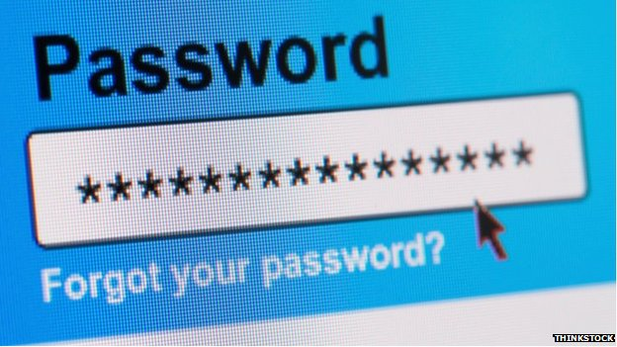
Password-Boon OR Curse???
A password is a word or string of characters used for user authentication to prove identity or access approval to gain access to a resource (example: an access code is a type of password), which should be kept secret from those not allowed access.
Various Password Policies-various Degrees of Security
Weak Passwords-Easy to Crack
Risk of exposure of highly confidential data

Slide 3
Strict Password Policies
Noting down password[RISKY]
Periodic password change
Complicated Password
Strict Password Policies

Slide 4
Study on Passwords
30% Passwords are ridiculously easy to guess
50% users use the same or repeated passwords
31% always use different passwords
On an average, users change password 7 times a year,
96% of the time prompted by organization
Forgetful nature of humans

Slide 5

Need of the hour
Password decentralized/independent system is needed
User friendly
Less strict password policies
User personalized

Slide 6
Security systems
Vulverabilty
Cloud computing
Aviation
Bluetooth security
Portable
FULLPROOF System
Technologically advanced
Notification/Warning in case of threats

Slide 7
Overview of the Software

Slide 8

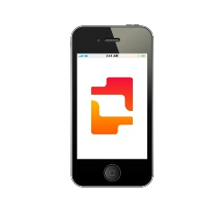


First Login
Bluetooth enabled laptop/computer starts
Software will run as background process
User will scan Bluetooth devices
Users pairs with his Cell Phone
Creates profile, Sets it active , Saves Profile
Chooses working folder , Protection is enabled for that folder

Slide 9

Real Time Protection
Protection
Bluetooth in range:
>Prompt for password
>Decrypt all the files
Bluetooth not in range:
>Protection enabled
>Encrypt all the files
>Never ask for password
PAIRED

Slide 10
Concept
Connection between laptop and the Device
Software will run as a background process
JSR-82 is a java specification for defining APIs for communicating with Bluetooth devices
Encryption
Encryption of files will be done using Rijndael Encryption algorithm
Discover Bluetooth devices
Pairs with the Bluetooth devices using MAC Address of the device
Software will implement handshake protocol every 5 seconds with device
If device not in range, All working files will be encrypted

Slide 11
WHY Rijndael Encryption Algorithm??
Rijndael Cipher is an Advanced Encryption Standard(AES)
Satisfies High Speed Low RAM Requirement
Extremely difficult to Hack!
Fast in BOTH Software and Hardware
Rijndael specification per se is specified with block and key sizes that may be any multiple of 32 bits, both with a minimum of 128 and a maximum of 256 bits.
AES has been Wholely adopted by US Government

Slide 12

Literature Review
Cryptography is a science and an art to keep the confidentiality of news
Cryptography alters the original messages into secret codes called encryption and, conversely called as decryption.
Rijndael Algorithm Well Explained as a 4 process Algorithm
Algorithm can be implemented in JAVA Programming Language
Less Strict Password Policies
User Friendly system

Slide 13

Advantages
Advantages
Existing Windows Password Security
Password Policies
Cost

Slide 14

Existing Windows Password Security
Password Feature is tied to User Accounts
Administrator can play with the passwords of other users
All the users have access to the files and folders in the drive
The LC5 Program!!!
The important files and folder will be protected regardless the password is known to anyone else

Slide 15
Password Policies
Imposition of forced Password Policies by Organisation
Leads to generation to tedious Passwords
Change of password in a day or Week Mandatory
Users start to note the password down-Potentially High Risk!!
Passwords prediction are possible depending upon the personality of the user and his desk.
Software will be a huge advantage for organizations and Users

Slide 16
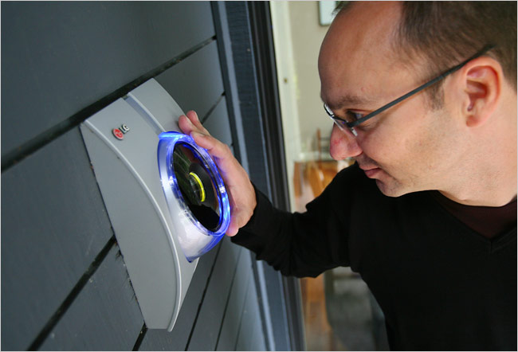
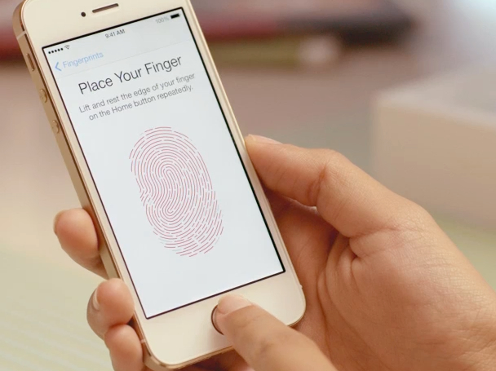
Cost
Password Decentralized/Authentication Systems are available
Example, Finger Print Authentication, Retina Scan Authentication, Heart beat Sensor Authentication , Brain waves Authentication , Etc..
Software will be cost effective compared to above mentioned softwares.

Slide 17
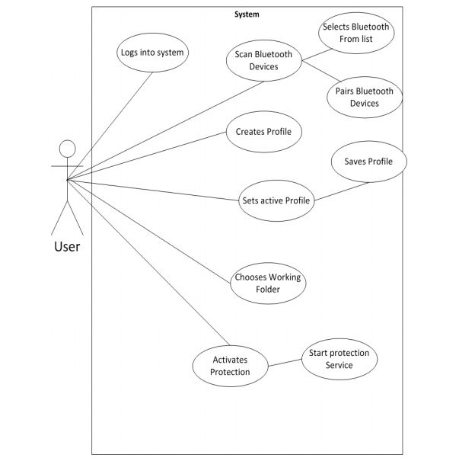
System Design

Slide 18
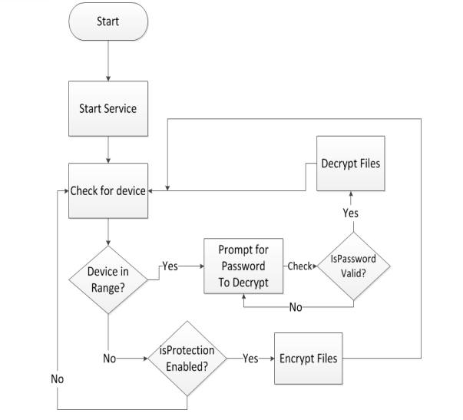
Windows Service

Slide 19
Implementation Module
Design
Coding
Analysis
Testing

Slide 20

Analysis
Analyzing Requirements
Understanding
Planning
Cost

Slide 21
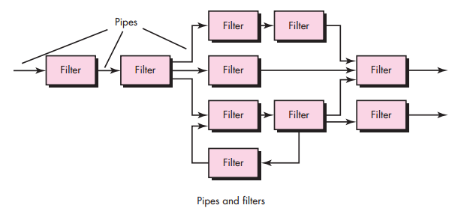
Design
Architectural Design
Architectural design represents the structure of data and program components that are required to build a computer-based system.
Component Level Design
Component-level design defines the data structures, algorithms, interface characteristics, and communication mechanisms allocated to each software component.
User Interface Design
User interface design creates an effective communication medium between a human and a computer.

Slide 22

Coding
Interface Coding:
Java SE 6
NetBeans IDE 7.3 Debugger/Notepad/Lite-Pro Edition (LE-PRO)
Bluecove is a JSR-82 implementation. JSR-82 is a java specification for defining APIs for communicating with Bluetooth devices.
Platform-WINDOWS 7/8

Slide 23

Testing
Unit Testing
Integration Testing
Validation Testing
-Testing
β-Testing

Slide 24
Requirements
For Fluent Communication between Bluetooth Devices,
Java SE 6
NetBeans IDE 7.3 Debugger/Notepad/Lite-Pro Edition (LE-PRO)
Bluecove is a JSR-82 implementation. JSR-82 is a java specification for defining APIs for communicating with Bluetooth devices.
Windows 7/8 OS
Hardware:
Mobile Phone with Bluetooth
Bluetooth dongle Plug’n’Play(External Bluetooth Device)
PC or Laptop
Windows Service:
Lifetime service
Scan Bluetooth Proximity
Encrypt Files
Lock workstation

Slide 25
Future Plans
Allowing pairing for 2 mobile phones(Just in case!)
Alternate means of Secret Encryption if Bluetooth fails
Securing Bluetooth in Android Devices(Requirement to learn android)

Slide 26
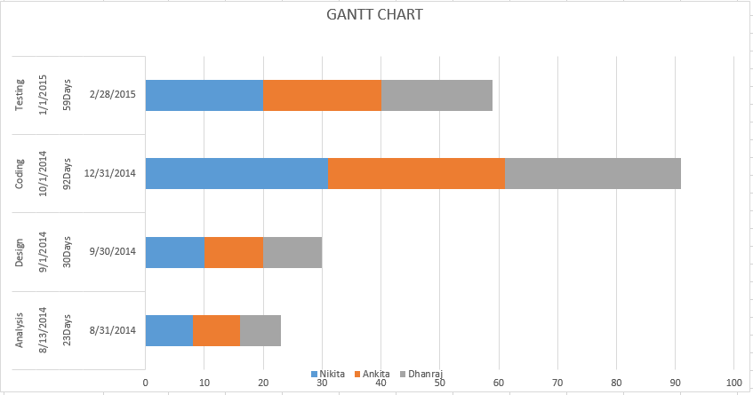
GANTT Chart

Slide 27


